Slide 1
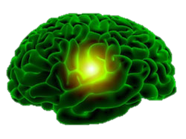
The Social Stress Resiliency Playoffs: Playoffs for the Resiliency cup Microbiome vs. Brain’s Social Stress Reaction
Social Stress & Resilience: Fall 2017
Clarissa Staton

Slide 2
The Social Stress Resilience Playoff Schedule
Last Weeks Matchup: Nicotine & Orexin vs. Brain’s Social Stress Reaction
This week’s Matchup: Microbiome vs. Brain’s Social Stress Reaction
All other games TBD
Notes:
Sucebtable because this is your brains natural reaction
Resilienct because this is what is coming in to make the difference

Slide 3
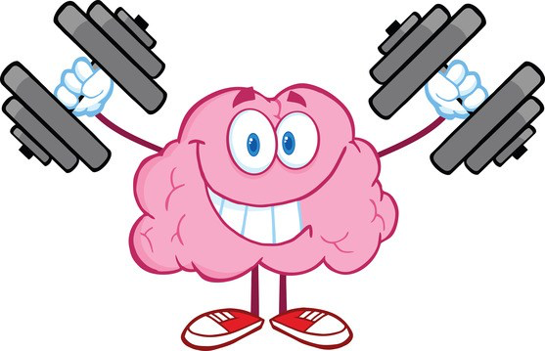
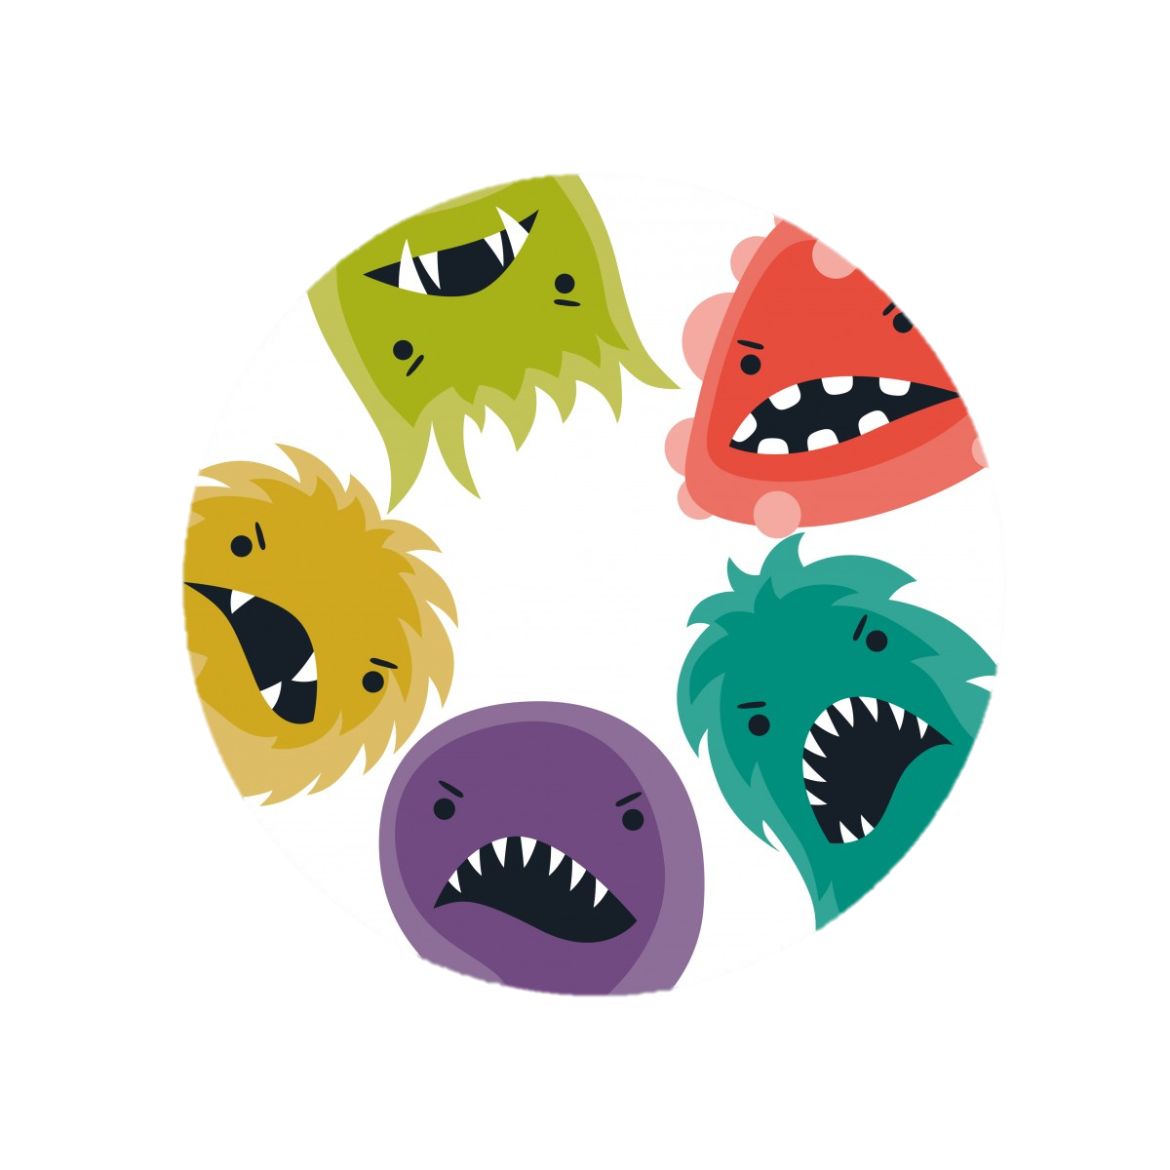
Game 2: Microbiome vs. Brain
Home Team: Brain’s Social Stress Reaction
Players:
???
Away Team RESILIENCE : Microbiom
Players;
Lactus basilius
Other germs (probably)
Notes:
Sucebtable because this is your brains natural reaction
Resilienct because this is what is coming in to make the difference

Slide 4
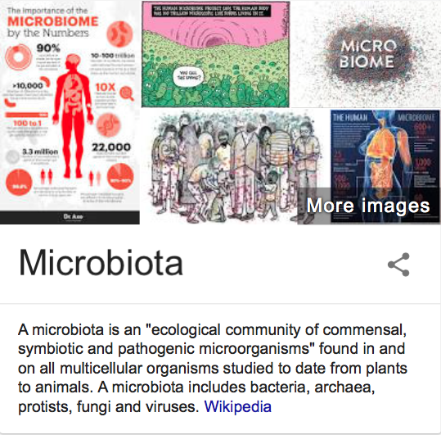
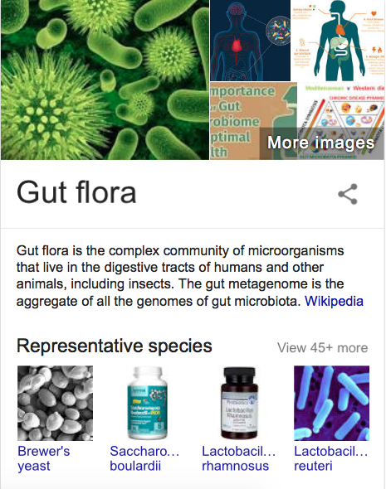
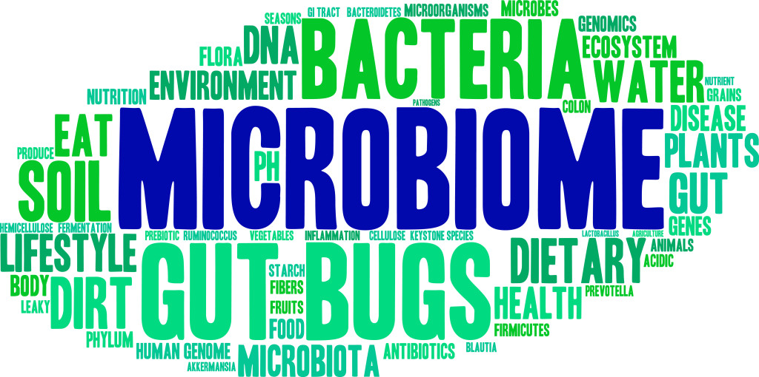
Team Microbiome’s Record

Slide 5
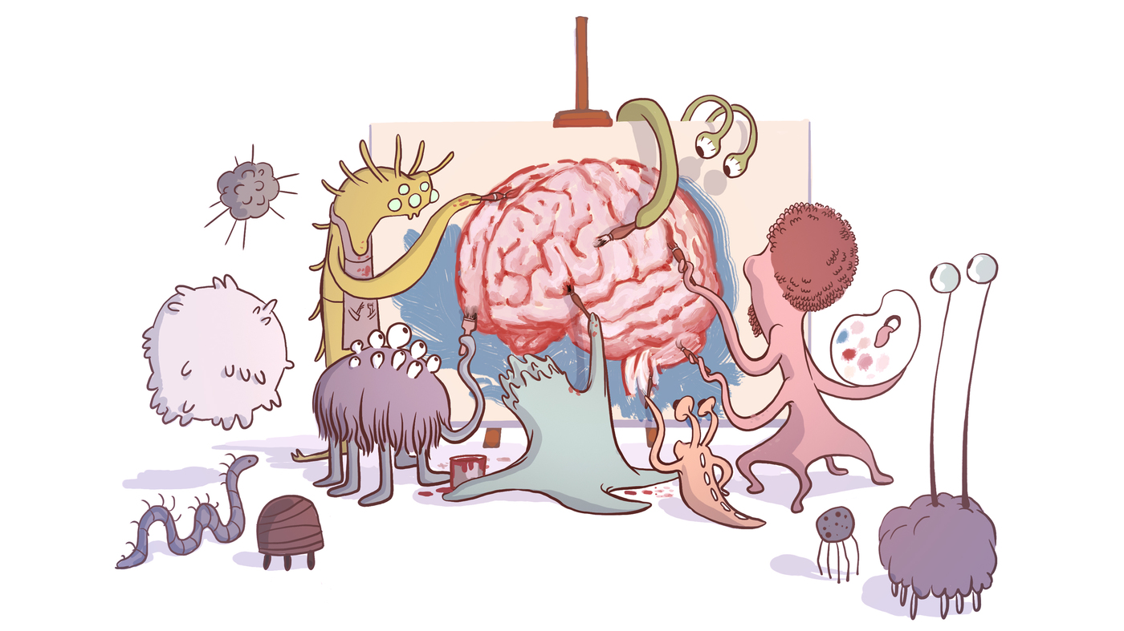
Team Microbiome’s Record: Microbiota-gut-brain axis
Bidirectional communication between brain & intestinal microbiota
Required for;
HPA axis function
Stress responsivity
Social cognition
Disrupting could lead to;
Anxiety disorders

Slide 6
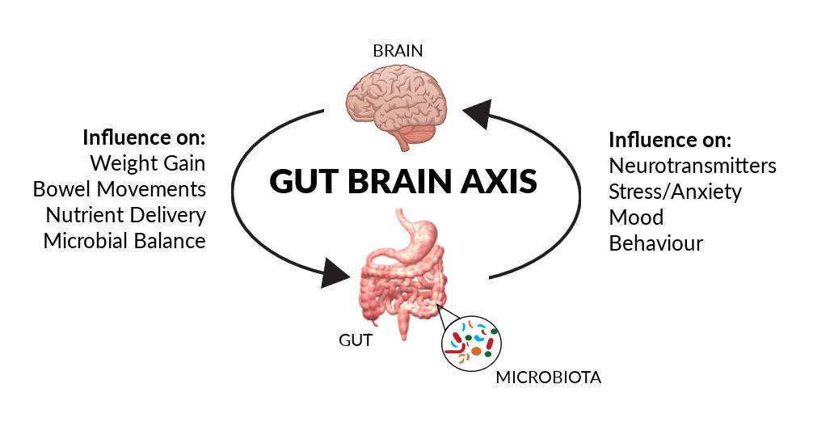
Team Microbiome’s Record: Microbiota-gut-brain axis

Slide 7
First Quarter Summary: The microbiome overcomes Brain’s reaction to stress
Ingestion of Lactobacilus strain regulates emotional behavior and central GABA receptor expression via the Vagus Nerve
Javier A. Bravoa,1, Paul Forsytheb,c,1, Marianne V. Chewb, Emily Escaravageb, Hélène M. Savignaca,d, Timothy G. Dinana,e, John Bienenstockb,f,2, and John F. Cryana,d,g,2

Slide 8
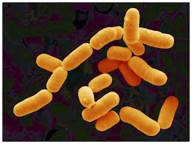
First Quarter Game Plan: Methods
Stress-Induced hyperthermia (SIH)
Elevated plus maze (EPM)
Forced swim test (FST)
Fear conditioning (FC)
Open field (OF)
Treatment
-Control or JB-1
Treatment cont.
Corticosterone
1
28
Days Passed
Treatment= Administration of Lactobacillus rhamnosus (JB-1)

Slide 9
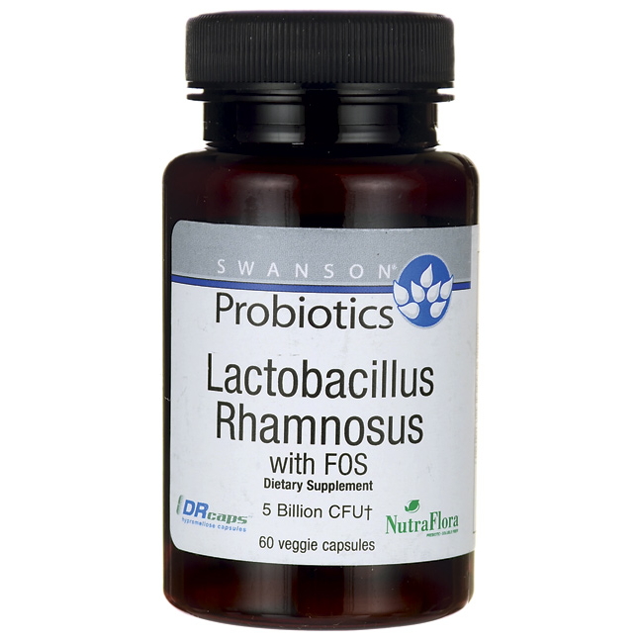
Lactobacillus rhamnosus (JB-1)
Bacterium
Found naturally in the gut
But also used in probiotics

Slide 10
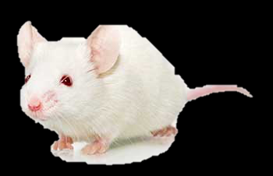
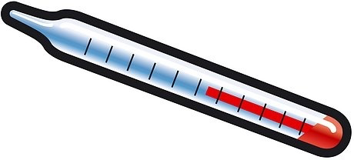
First Quarter Game Plan: Stress-Induced Hyperthermia
10 min
Greater ΔT=more anxiety
Notes:
Change in temperature is measured → greater temp change= more anxiety

Slide 11
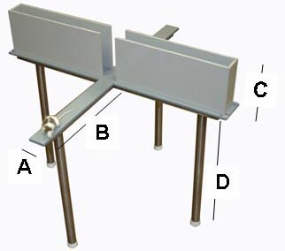
First Quarter Game Plan: Elevated-Plus Maze
More time in open arms=less anxiety
5 min
Notes:
More time in open arms=less anxiety

Slide 12
First Quarter Game Plan: Forced Swim Test
More movement=less anxiety
Only last 4 min scored
6 min

Slide 13
First Quarter Game Plan: Fear Conditioning
Day 1: Training Day
Day 2: Memory Testing
Day 3: Memory Extinction

Slide 14
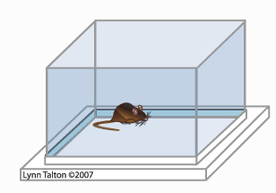
First Quarter Game Plan: Forced Swim Test
OFC used to induce stress
For corticosterone levels

Slide 15
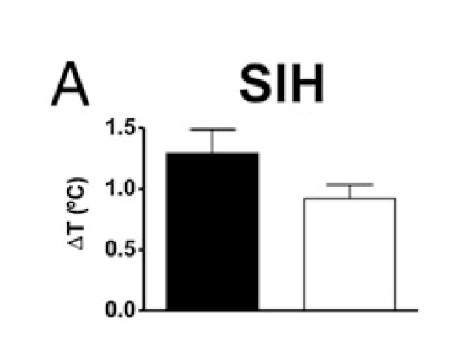
First Quarter Play by Play: Stress-Induced Hyperthermia Results
JB-1 showed trend towards a ⬇ in the ΔT

Slide 16
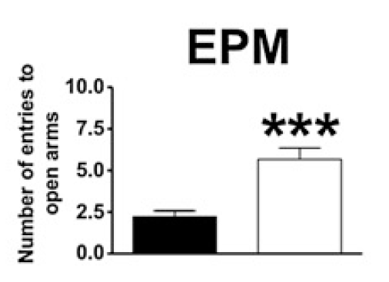
First Quarter Play by Play: Elevated Plus Maze Results
JB-1 mice went into open arms more

Slide 17
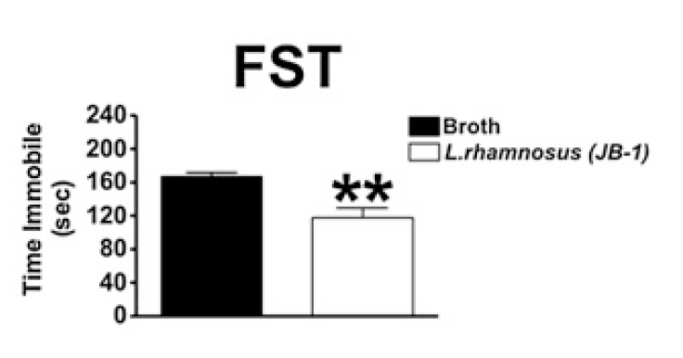
First Quarter Play by Play: Forced Swim Test Results
JB-1 mice spent less time immobile

Slide 18
First Quarter Play by Play: Fear Conditioning Results
JB-1 mice showed more memory of FC

Slide 19
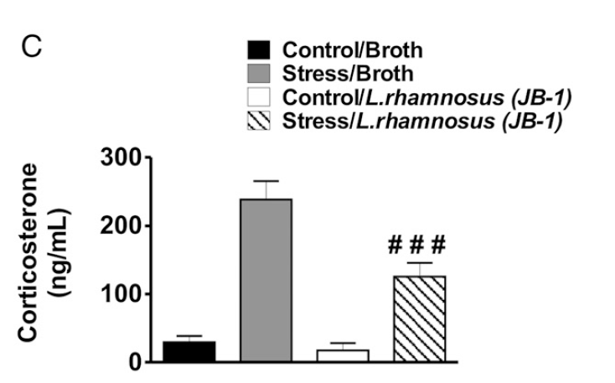
First Quarter Play by Play: Corticosterone Results
JB-1 stressed mice had lower corticosterone levels

Slide 20
Second Quarter Summary: The microbiome overcomes the brain’s reaction to social stress
Oral treatment with Lactobacillus rhamnosus attenuates behavioural deficits and immune changes in chronic social stress
Aadil Bharwani1,2,3, M. Firoz Mian2, Michael G. Surette4,5, John Bienenstock1,2 and Paul Forsythe2,4,6*

Slide 21
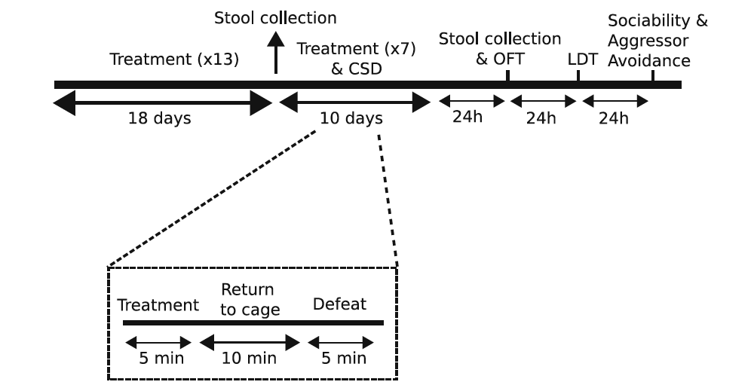
Second Quarter Game Plan: Overview

Slide 22
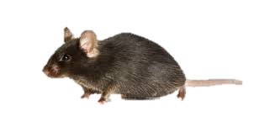
Second Quarter Plan: Bacterial Treatment

Slide 23
Second Quarter Game Plan: Treatment + Social Defeat
CSD=Chronic Social Defeat

Slide 24
First Half Game Plan
Second Quarter Game Plan: Treatment + Social Defeat

Slide 25
First Half Game Plan
Second Quarter Game Plan: Treatment + Social Defeat
Housed across from each other for 24 hrs following defeat
Only mice with defeated phenotype were used.
Notes:
-After each defeat, mice were housed across from each other for the next 24 hrs

Slide 26
Second Quarter Game Plan: OFC
OFT=Open Field Test
Measures Anxiety
Plexiglas enclosure
Each test=30 min

Slide 27
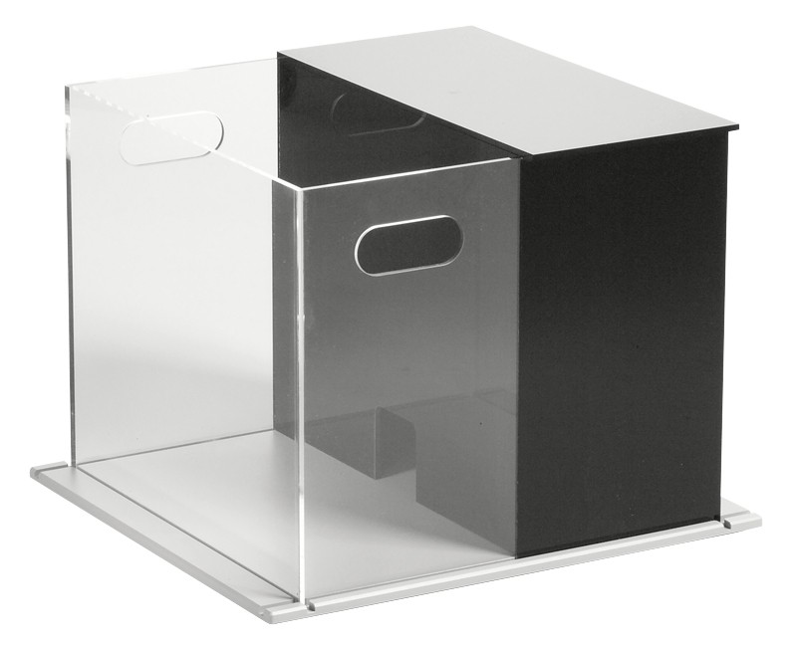
Second Quarter Game Plan: LDT
LDT=Light-dark box test
Measures Anxiety
Plexiglas enclosure w/ black insert at one end
Each test=10 min

Slide 28
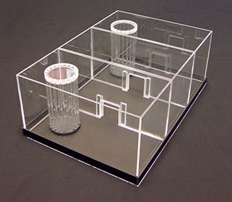
Second Quarter Game Plan: Sociability & Avoidance Tests
Three-Chamber Sociability Test
Aggressor Approach-Avoidance Test

Slide 29
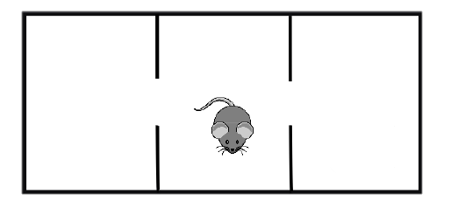
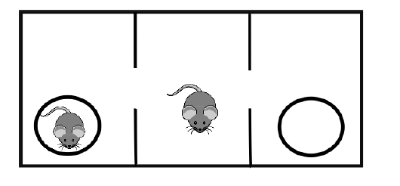
Second Quarter Game Plan: Three-Chamber Sociability Test
Three-Chamber Sociability Test
Habituation Phase=5 min
Sociability Phase=10 min
5 min
10 min

Slide 30
Second Quarter Game Plan: Aggressor Approach-Avoidance Test
Aggressor Approach-Avoidance Test
2 sessions (2.5 min each)
1st=no aggressor
2nd=aggressor

Slide 31
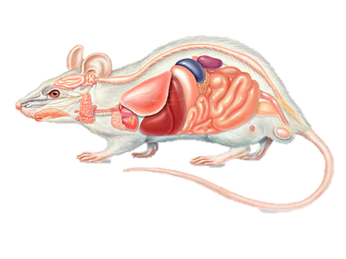
Second Quarter Game Plan: Sociability & Avoidance Tests
Following behavioral test mice either;
Killed
Spleens taken
Brains taken
Frontal cortex and hippocampus macrodisesected
Kept for additional testing (3 weeks later)

Slide 32
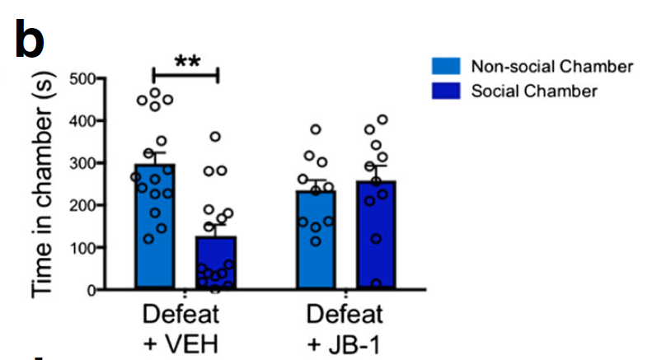
Second Quarter Play by Play: 3-Chamber Test Results
JB-1 attenuated effects of defeat on Social avoidance during 3-chamber test
Notes:
-Vehicle treated mice avoided social chamber
-JB-1 treated mice did not avoid the chamber

Slide 33
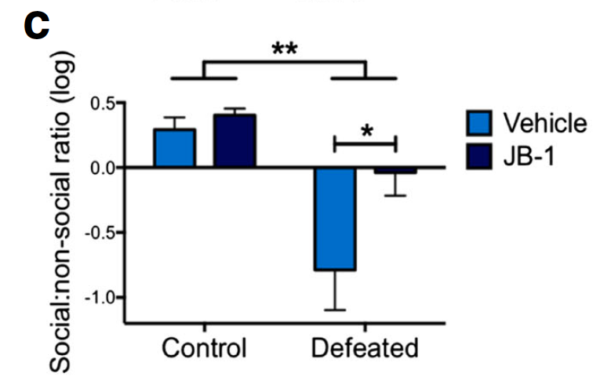
Second Quarter Play by Play: 3-Chamber Test Results
and… gave a bigger social:non-social ratio
Notes:
-Compared to Controls, defeated JB-1 treated mice have greater social: non-social ratio

Slide 34
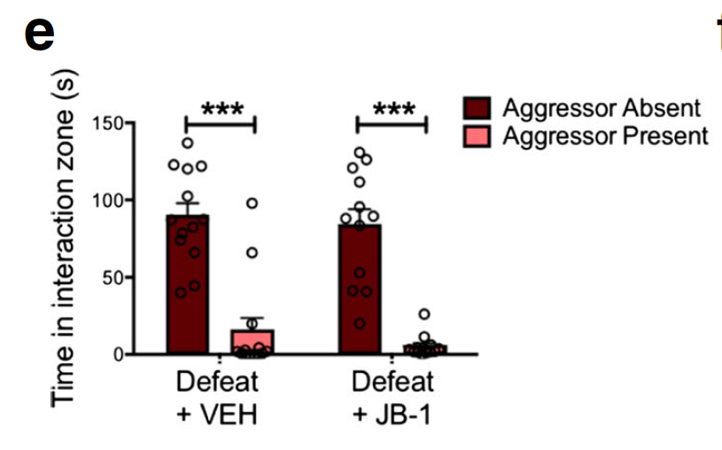
Second Quarter Play by Play: Social Avoidance Test Results
But.. both treatments showed avoidance of aggressor during avoidance test
Notes:
-Compared to Controls, defeated JB-1 treated mice have greater social: non-social ratio

Slide 35
Second Quarter Play by Play: Social Tests Challenge Review!
Hmm.. But wait. We need a review by the referee(s)…
Why would we get such different results for 2 similar but different social tests?
Notes:
-

Slide 36
Second Quarter Play by Play: Social Tests Challenge Review!
Blk6
Blk6
CD1
Blk6
Notes:
-The answer may be in the TYPE of social situation
- In the 3-Chamber test, the BLk6 was with a mouse of the same species
-In the Social avoidance test, the mouse was with an aggressive mouse
**Could it be possible that the 3-chamber is a better test for depression, while the SI is a better test for social anxiety

Slide 37
Second Quarter Play by Play: Social Tests Challenge Review!
Blk6
Blk6
Blk6
CD1
Could it be possible that there are differences in social behavior depending on the stimuli?
Threatening stimuli
Non-threatening stimuli
Notes:
**Could it be possible that there are two responses based on the type of stimuli?

Slide 38
Second Quarter Play by Play: Social Tests Challenge Review!
Blk6
Blk6
Blk6
CD1
Furthermore..
There must be different neural circuitry for these two different stimuli..
Does this mean that JB-1 is working on one circuit and not the other?

Slide 39
So does anxiety change with treated mice that have received social stress

Slide 40
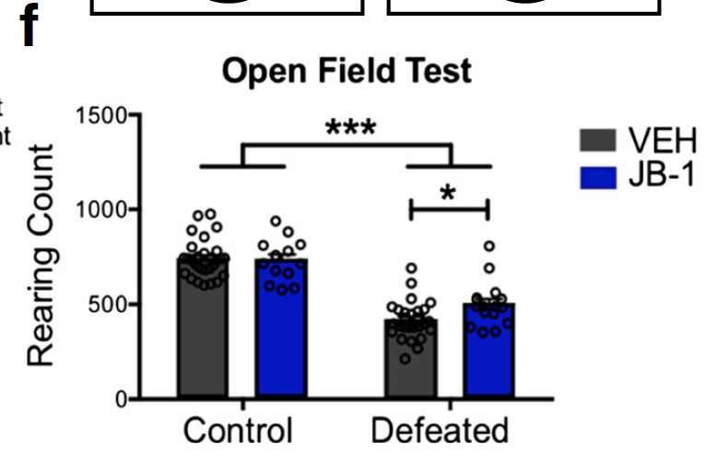
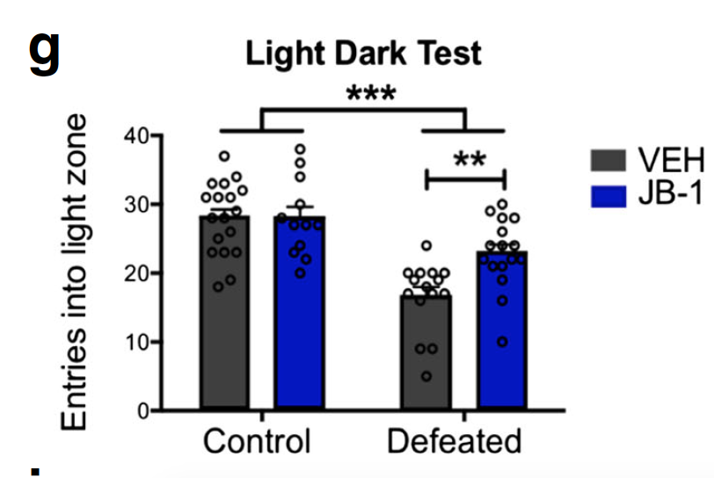
Second Quarter Play by Play: Anxiety Tests Results
JB-1 treatment also seemed to reduce animal’s general anxiety
Notes:
-Rearing= they consider it a non-anxious behavior

Slide 41
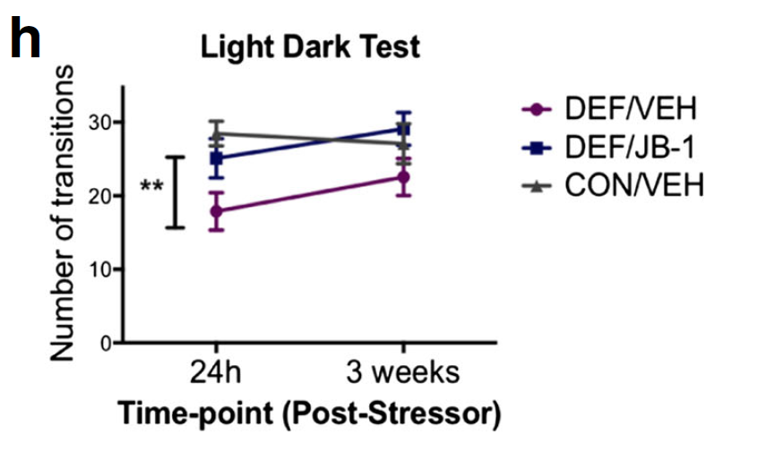
Second Quarter Play by Play: Anxiety Tests Results
and… these effects lasted 3 weeks after
Notes:
-Rearing= they consider it a non-anxious behavior

Slide 42
Couldn’t these behavioral changes just be due to more diversity of microbiome by giving treatment? (restoration of microbiome)
No.. Because…

Slide 43
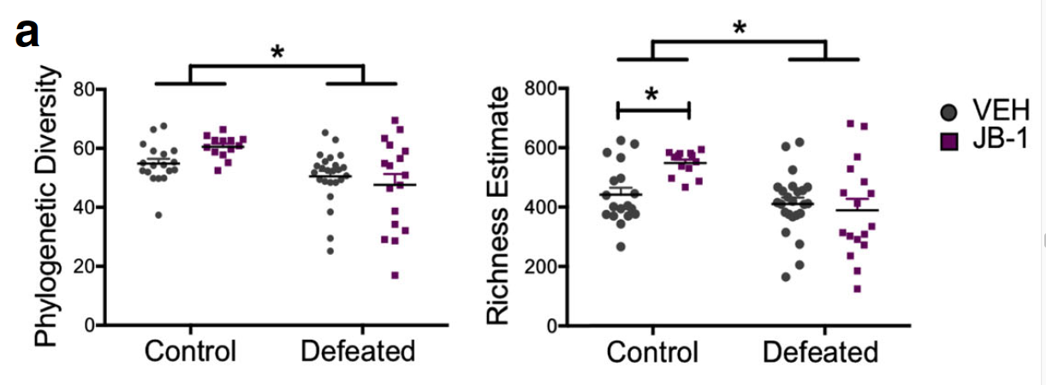
Social Defeat affects microbiome diversity
JB-1 treatment does not prevent these changes

Slide 44
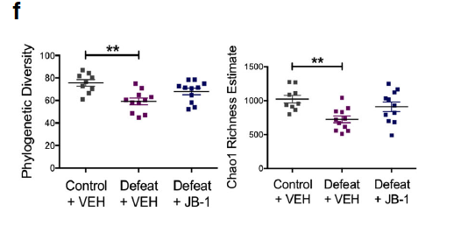
Social Defeat affects microbiome diversity
JB-1 treatment does not prevent these changes
After 3 weeks either

Slide 45
But…How is the microbiota.. From the gut.. Affecting the brain?

Slide 46
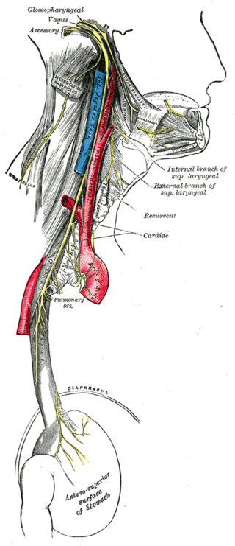
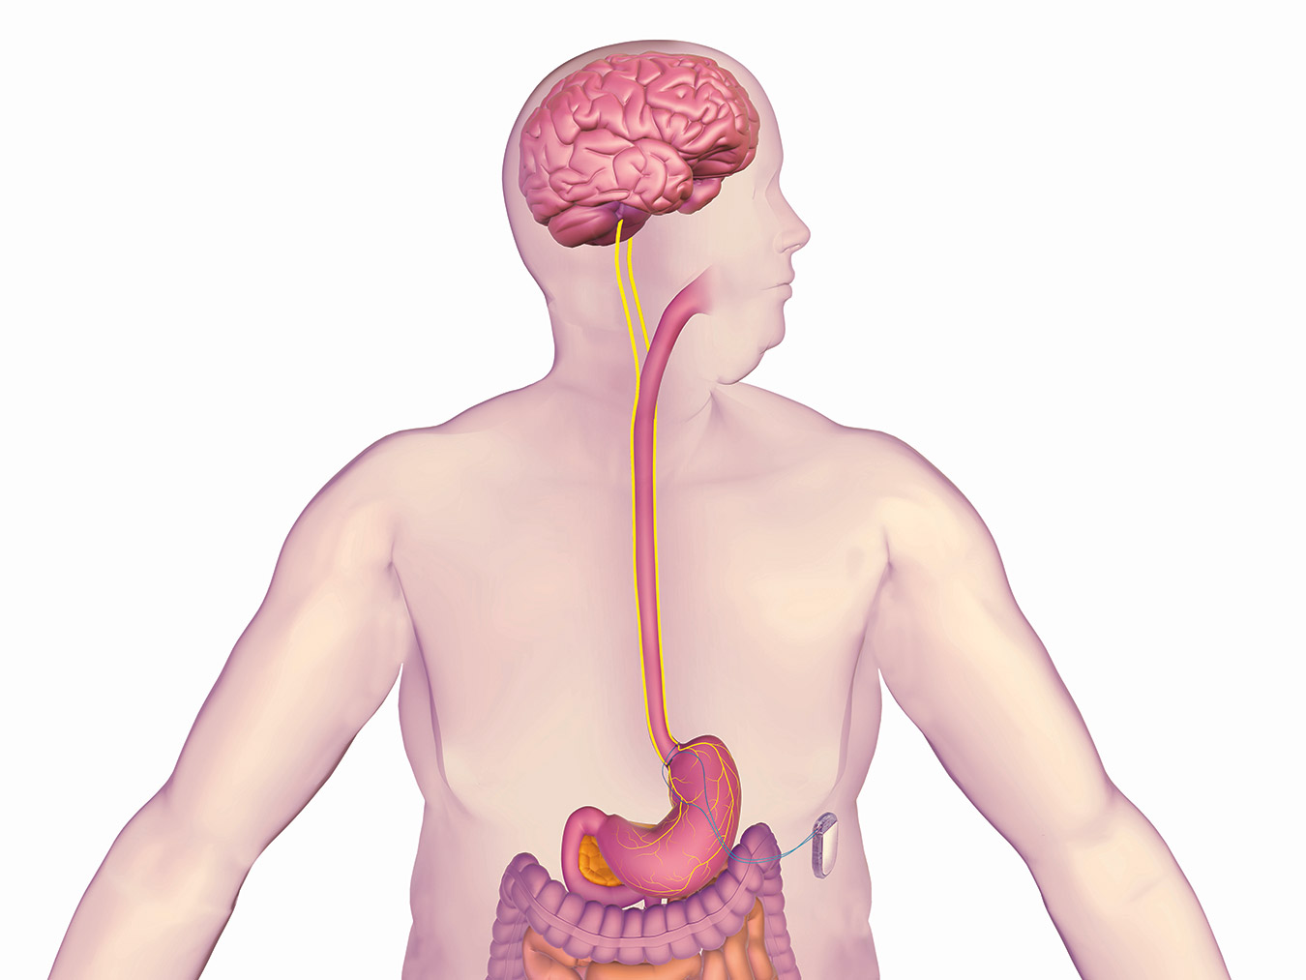
The Vagus nerve…..
Connects CNS with gut
GABA
Shown to modulate behavior
Mechanism as to how vagus nerve effects brain via gut is unknown

Slide 47
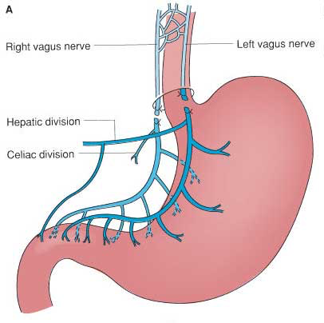
To test this
Vagotomy (V_{x})
Or Sham

Slide 48
This data supports that the vagus nerve is governing the behavioral effects of JB-1

Slide 49
Halftime!

Slide 50
Halftime Recap
Treatment with microbiota can;
Reduce stress/anxiety
Reduce social stress/anxiety
The brain & microbiota effect happen via vagus nerve
Microbiota is winning against stress!

Slide 51
Halftime Recap
But… questions still remain....
Who has microbiota been targeting?
Through which mechanisms are they targeting the brain?

Slide 52
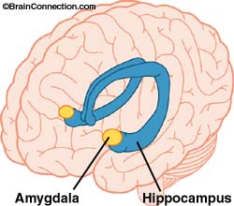
Oh snap!! Who is that coming out for the brain?
And the hippocampus!
It’s the amygdala!

Slide 53
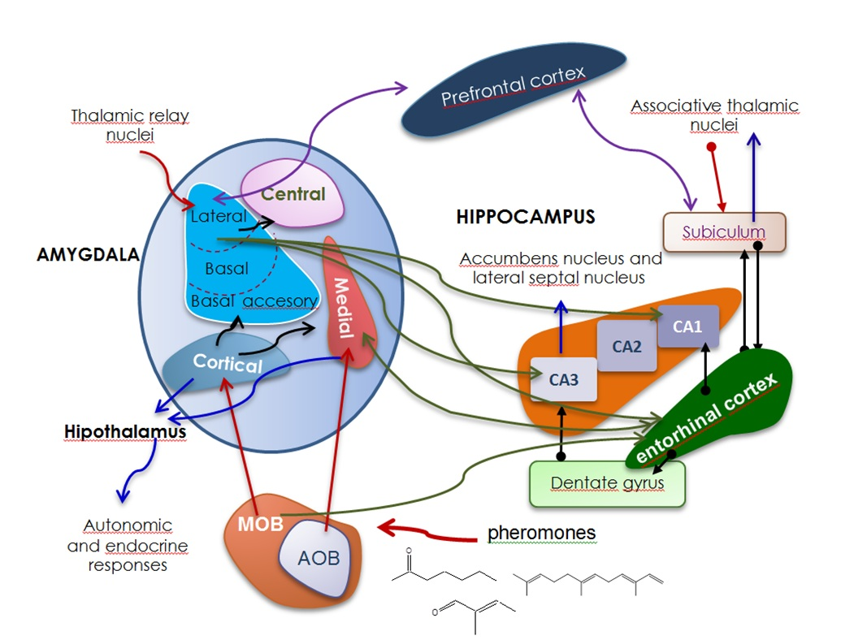
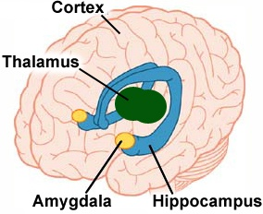
The Amygdala’s Stats
Important in:
Fear & anxiety responses
Stress resiliency?
Notes:
BLA & LA receive input and send it to the CeA
Stimulation from BLA to CeA produces anxiolytic effect
But stimulation of BLA as whole has anxiogenic effect

Slide 54
The Hippocampus’s Stats
Important in:
Memory
Behavior processes
FC
Notes:
-Stimulation of BLA to Ventral hippo=increased anxiety

Slide 55
Third Quarter Summary: The Microbiome Changes the Amgydayla and Hippocampus
Adult microbiota-deficient mice have distinct dendritic morphological changes: differential effects in the amygdala and hippocampus
Pauline Luczynski,1 Se an O. Whelan,2 Colette O’Sullivan,2 Gerard Clarke,1,3 Fergus Shanahan,1 Timothy G. Dinan1,3 and John F. Cryan1,2

Slide 56
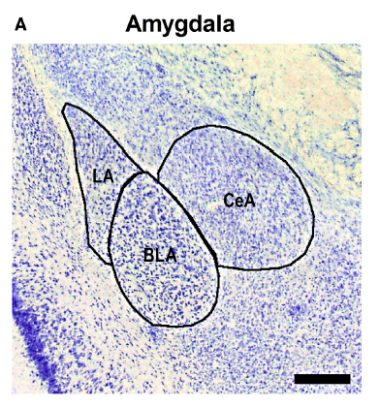
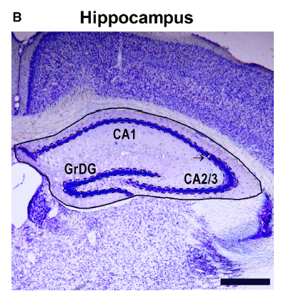
Third Quarter Game Plan: Morphology of the amygdala and hippocampus
Groups: Germ-free (GF) mice & pro-germ controls
Amygdala
Hippocampus
BLA
LA
CeA
Dorsal
Ventral
DG
Other fields
Aspiny Neurons
Pyramidal Neurons
Granule Cells

Slide 57
Third Quarter Game Plan: Morphology of the amygdala and hippocampus
Aspiny Neurons
Usually GABA
Found in;
Amygdala
And other regions

Slide 58
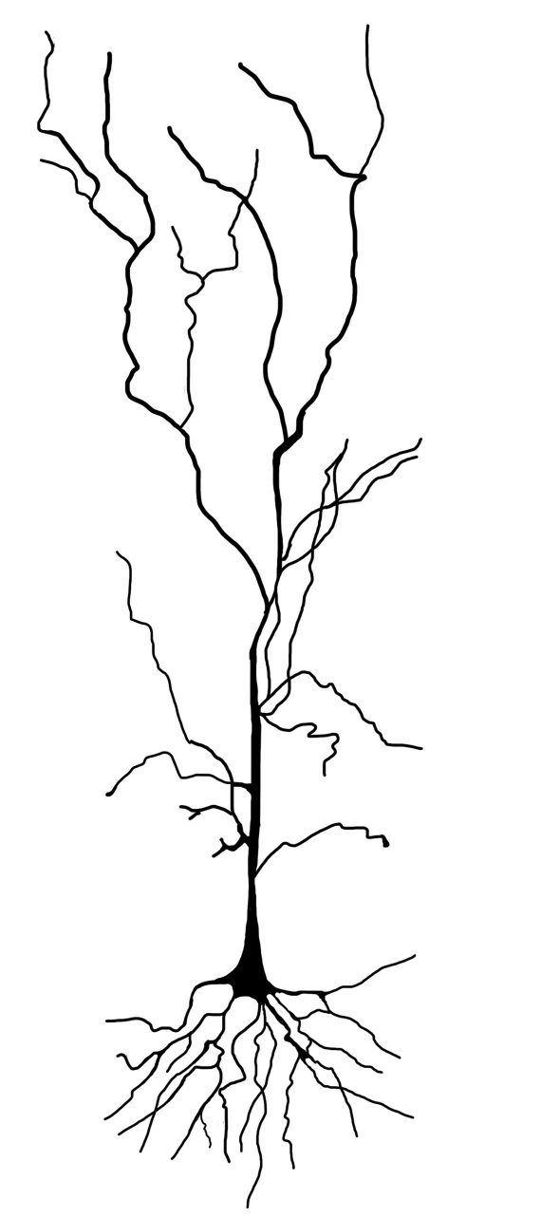
Third Quarter Game Plan: Morphology of the amygdala and hippocampus
Pyramidal Neurons
Usually excitatory
Found in;
Amygdala
Hippocampus
Prefrontal cortex
And other regions

Slide 59
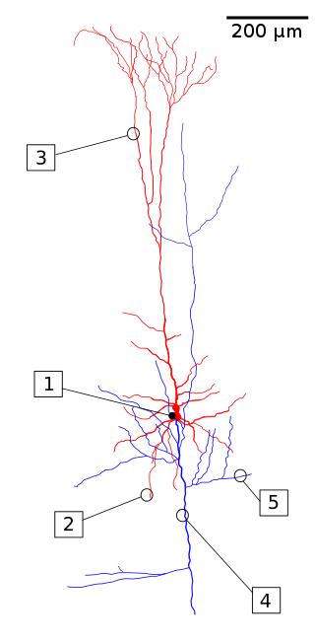
Third Quarter Game Plan: Morphology of the amygdala and hippocampus
Pyramidal Neurons
Apical Dendrites
#3
Basilar Dendrites
#2
Thin spines
Filopodia Spines
Stubby spines
Mushroom spines

Slide 60
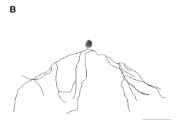
Third Quarter Game Plan: Morphology of the amygdala and hippocampus
Grannule cells
Usually excitatory
Release glutamate
Found in;
Hippocampus
Cerebral cortex
And other regions

Slide 61
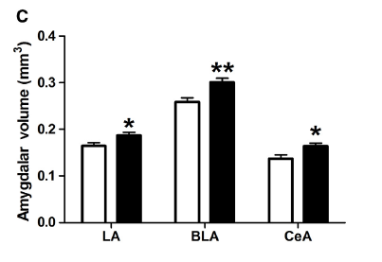
Third Quarter Play by Play: Lack of germs affects brain regions size
⬆ Amygdalar size in all regions

Slide 62
Third Quarter Play by Play: Lack of germs affects brain regions size
⬆ hippocampal size.. But only in CA2 and CA3
This gives the total brain result like we see

Slide 63
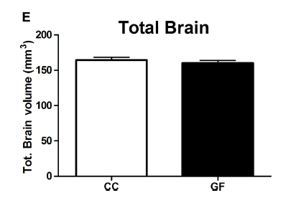
Third Quarter Play by Play: Lack of germs affects brain regions size
Not w/ total brain

Slide 64
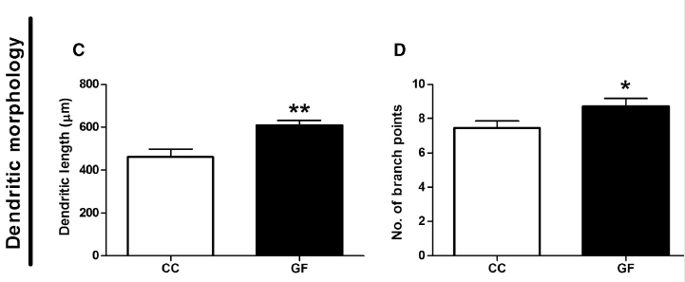
Third Quarter Play by Play: Lack of germs affect BLA neurons
Aspiny: ⬆ dendritic length & branching

Slide 65
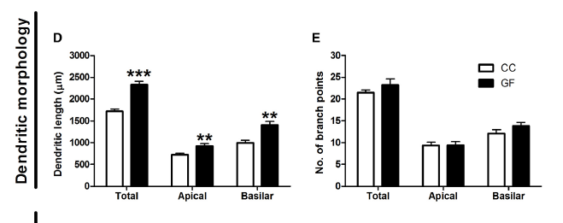
Third Quarter Play by Play: Lack of germs affect BLA neurons
Pyramidal: ⬆ dendritic length & branching

Slide 66
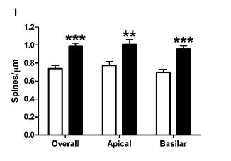
Third Quarter Play by Play: Lack of germs affect BLA neurons
Pyramidal: ⬆ spine density

Slide 67
Third Quarter Play by Play: Lack of germs affect BLA neurons
Pyramidal: ⬆ stubby & mushroom spines

Slide 68
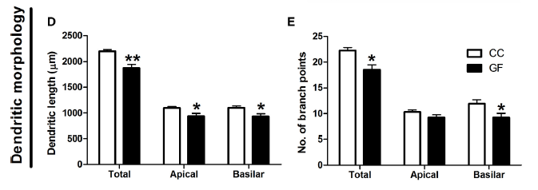
Third Quarter Play by Play: Lack of germs affect ventral hippocampus neurons
Pyramidal: ⬇ dendritic length & branching

Slide 69
Third Quarter Play by Play: Lack of germs affect ventral hippocampus neurons
Pyramidal: ⬇ dendritic density

Slide 70
Third Quarter Play by Play: Lack of germs affect ventral hippocampus neurons
Pyramidal: ⬇ stubby & mushroom spines

Slide 71
So by not having germs…
In the BLA we have
⬆GABAergic cell (aspiny)
⬆ excitatory cell (pyramidal)
In the ventral hippocampus we have
⬇ excitatory cells (pyramidal & granule)

Slide 72
Microbiota appears to still be winning..
Lack of germs → changes in our stress & resiliency circuitry

Slide 73
But... One question still remain’s to determine the fate of this game..
Through which mechanisms are microbiota targeting the brain?
Lets finish this microbiota!

Slide 74
Brining in our secret weapon.. Remember the teams....
Home Team: : Brain’s Social Stress Reaction
Players:
Amgydalya/Hippocampus
Away Team: Microbiome RESILIENCE
Players;
Lactus basilius
Other germs (probably)
And now…
GABA (who used to play for the home team and has now switched to the winning team!)

Slide 75
GABA Stats
Inhibitory neurotransmitter
2 types of receptors
GABA_{A} (ionotropic)
GABA_{B} (G-protein coupled)
Subunits GABA_{B1} & GABA_{B2}
Notes:
GABAB=role in mood & anxiety disorders

Slide 76
Forth Quarter Summary: The Microbiome uses GABA to finish off Brain’s Social Stress Reaction
Ingestion of Lactobacillus strain regulates emotional behavior and central GABA receptor expression in a mouse via the vagus nerve
Javier A. Bravoa,1, Paul Forsytheb,c,1, Marianne V. Chewb, Emily Escaravageb, Hélène M. Savignaca,d, Timothy G. Dinana,e, John Bienenstockb,f,2, and John F. Cryana,d,g,2

Slide 77
Fourth Quarter Game Plan: Methods (same as first quarter)
Stress-Induced hyperthermia (SIH)
Elevated plus maze (EPM)
Forced swim test (FST)
Fear conditioning (FC)
Open field (OF)
Brains taken
Treatment
-Control or JB-1
Treatment cont.
Corticosterone
1
28
Days Passed
Treatment= Administration of Lactobacillus rhamnosus (JB-1)
Run in situ hypridization to test for GABA_{Aα1}, GABA_{Aα2}, GABA_{B1b} mRNA

Slide 78
Third Quarter Play by Play: Microbiome ⬇/⬆ GABA in amygdala and hippocampus
⬇ GABA_{B1B} in amygdala and hippocampus

Slide 79
Third Quarter Play by Play: Microbiome ⬇/⬆ GABA in amygdala and hippocampus
⬇ GABA_{Aα2} in amygdala
and ⬆ DG of hippocampus

Slide 80
Third Quarter Play by Play: Microbiome ⬇/⬆ GABA in amygdala and hippocampus
This effect appears to be mediated by the vagus nerve

Slide 81
Third Quarter Play by Play: Microbiome ⬇/⬆ GABA in amygdala and hippocampus
This effect appears to be mediated by the vagus nerve

Slide 82
Fourth Quarter Recap
GABA receptors appear to be involved
Specifically those receptors which have been implicated in anxiety behavior
How still remains' largely unknown…

Slide 83
Major plays that could have affected game outcome
Is the immune system chiming in?
Notes:
IL10=anti-inflammatory cytokin
CD4=glycoprotein found on the surface of immune cells = educes anti-flamitory response
CD80, MHCII, and CD11 = spleen derived dendritic cells =induced immune response

Slide 84
Major plays that could have affected game outcome
Are metabolites playing a role?
Notes:
Suggest that JB-1 could alter function of existing gut microbiota without influencing composition

Slide 85
Final Game Summary:
Treatment with microbiome can promote;
Stress/Anxiety resiliency
Social Stress/Anxiety resiliency
Lack of germs leads to morphological changes in;
Amygdala
Hippocampus
GABA receptors appear to be involved in this mediation…
In the amygdala
In the hippocampus
There are potential plays that could affect the game outcome.. Eg.
What might this all look like in a picture?
Lets draw!

Slide 86
So who do you think won this playoff game?
Microbiome vs. Brain’s Social Stress Reaction

